Slide 1
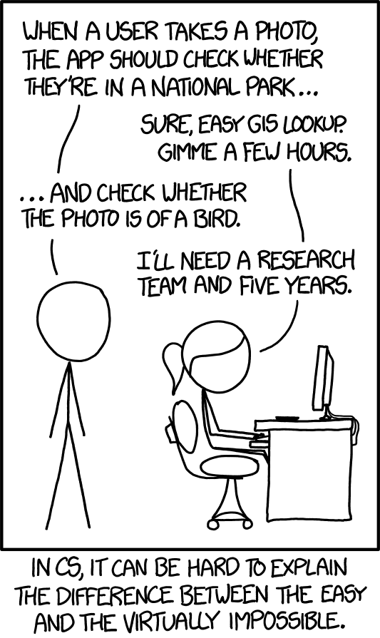
Emotion detection
By: Rey Reyes

Slide 2
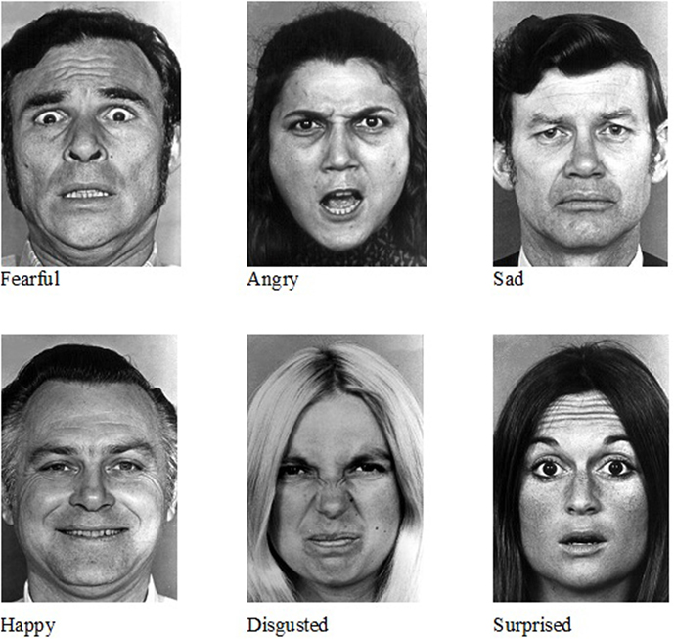
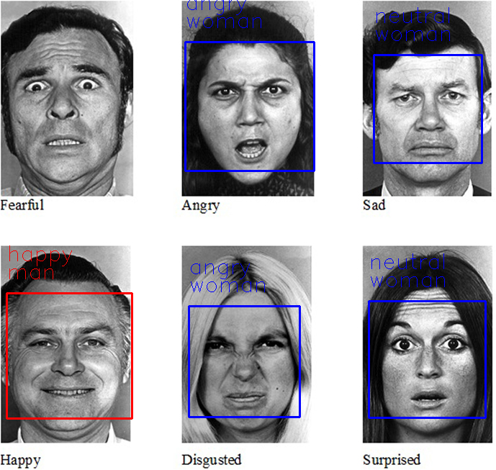
Paper Recreation
App Demo
Tech Stack
What I've Learned

Slide 3
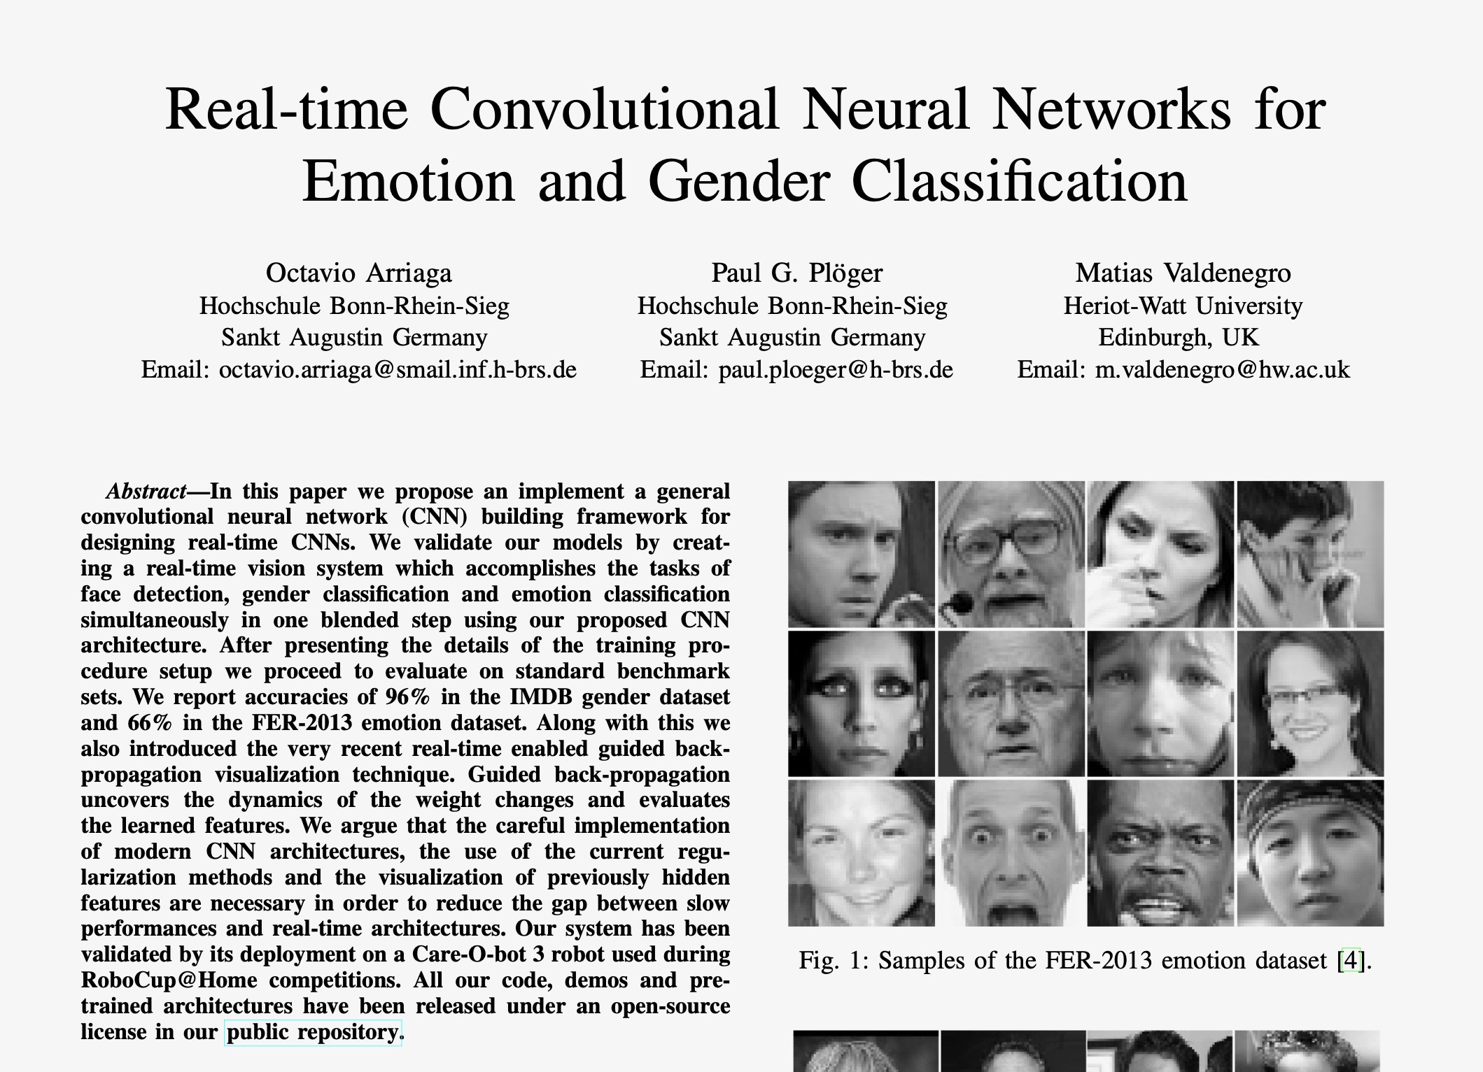
Paper recreation
I decided to replicate this paper written in 2017.
The original codebase was highly deprecated and incompatible with current libraries (e.g., outdated Keras/TensorFlow versions). I updated and refactored the code to work with modern frameworks.
Trained on IMDB & FER-2013 Dataset.
9 Convolution layers.
No frontend for users.

Slide 4
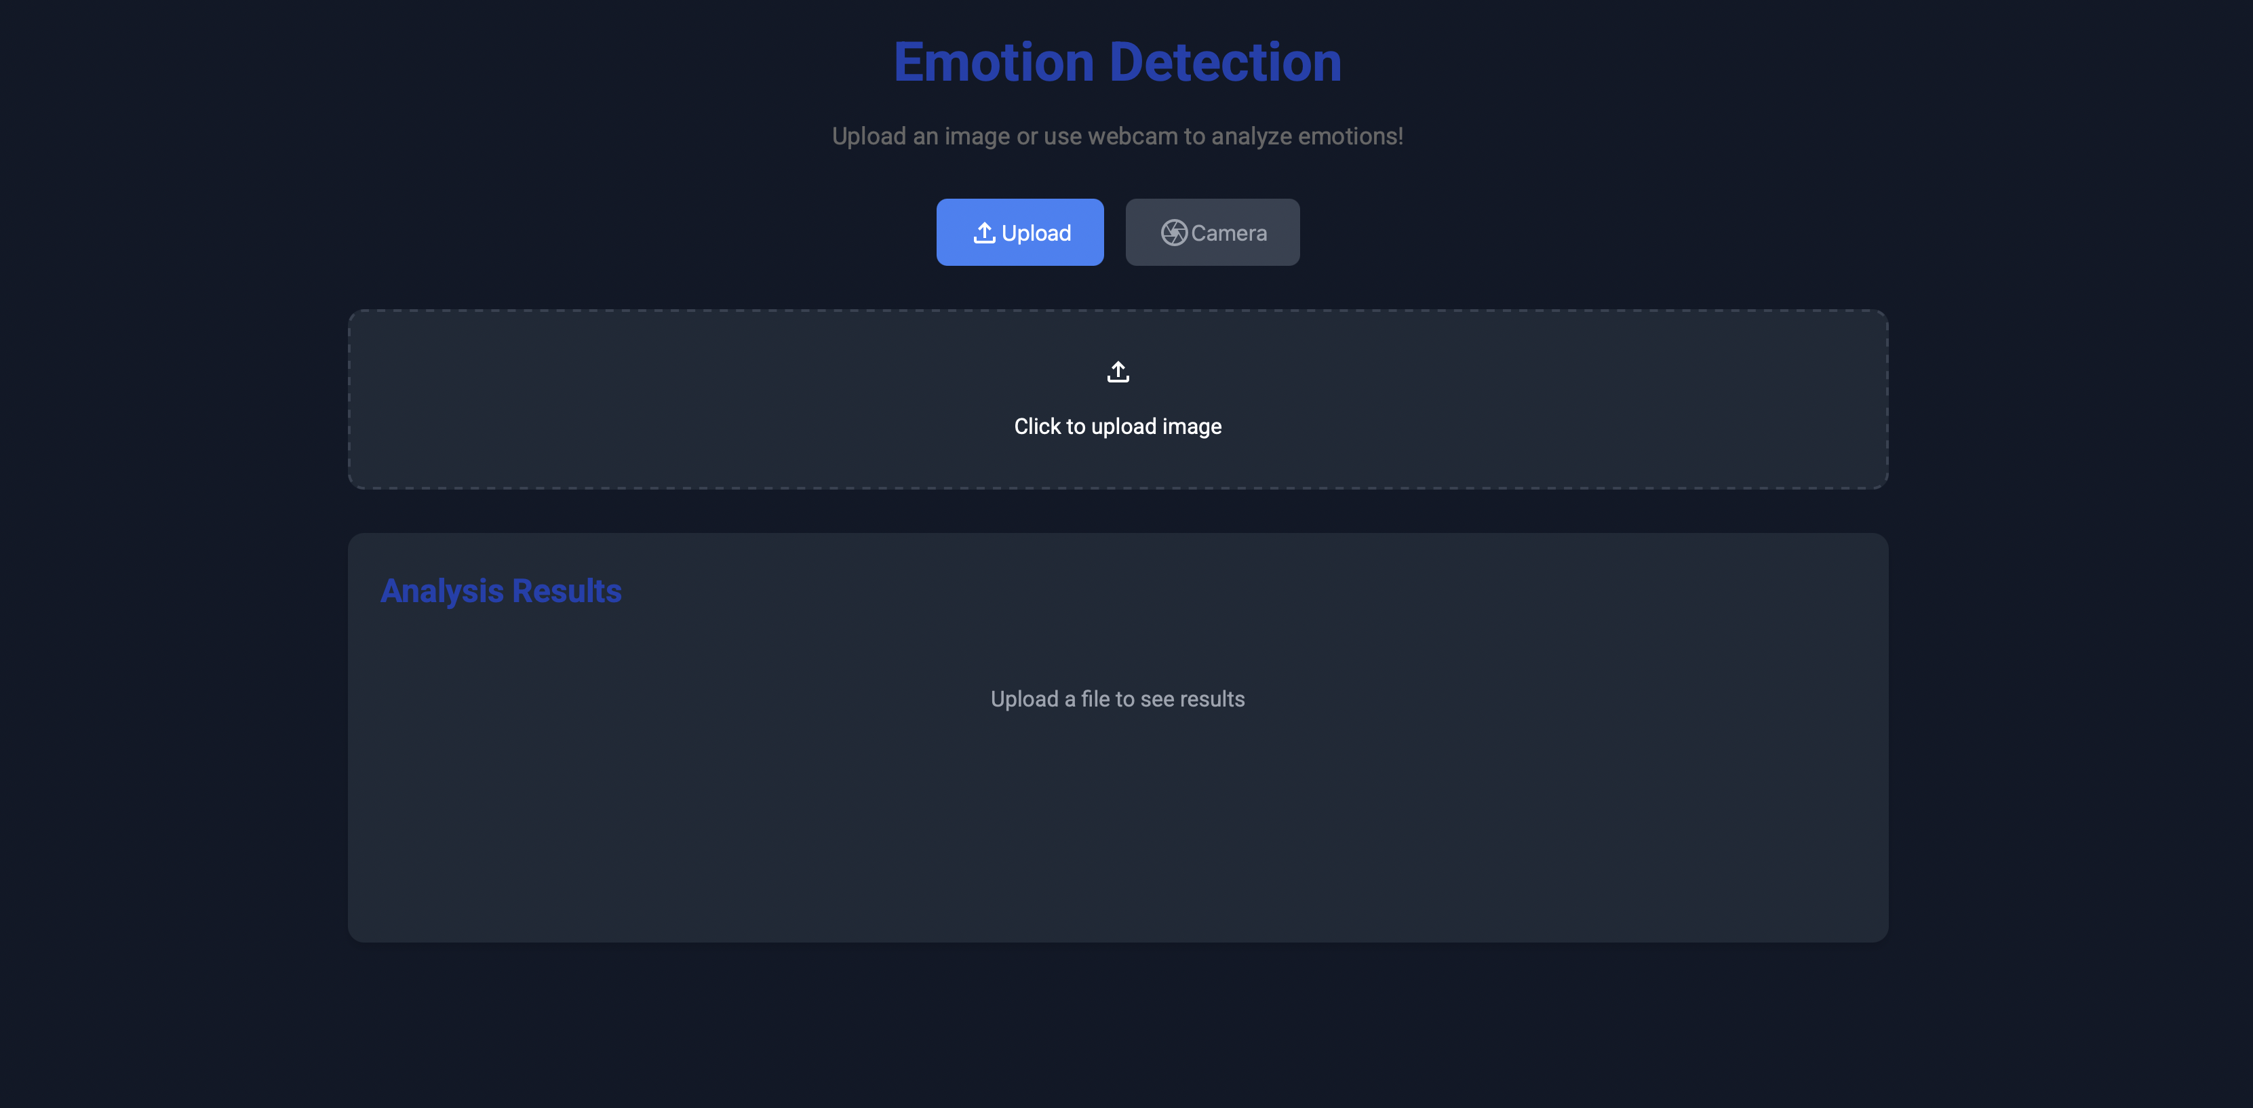
App demo

Slide 5
Tech stack
Frontend: Basic JavaScript, HTML, CSS
Backend: FastAPI, RestAPI
ML: CV2, Tensorflow, Keras.
Data Flow:
User uploads an image through the web interface or captures one via webcam
Image is sent to the FastAPI backend for processing
Backend processes:
Face detection using Haar Cascade
For each detected face:
Applies appropriate pre-processing based on model requirements
Runs the emotion detection model to classify emotions
Runs the gender detection model to classify gender
Results are returned to the frontend
Frontend displays results with confidence scores for each detected attribute

Slide 6
resources
https://github.com/oarriaga/face_classification
https://arxiv.org/abs/1710.07557

